Slide 1

MOOCs – The Future Is Getting Clearer
Charles Severance
International NCSC ONE Conference 2015
14-April-2015
Notes:
Total students: 363K, paid 3325 1/10 finished 1/100 paid 150K students 1486 books wholesale for my book $3.82

Slide 2
The Short Version of This Talk
Universities around the world are very busy using various types of involvement in the Massively Open Online Course (MOOC) movement as a way to reimagine how teaching is done and what it means to teach.
The results for most organizations so far are nearly all positive.
Notes:
It is not about transforming education – but it will transform education. Negative consequences are limited to the weak and marginal.

Slide 3
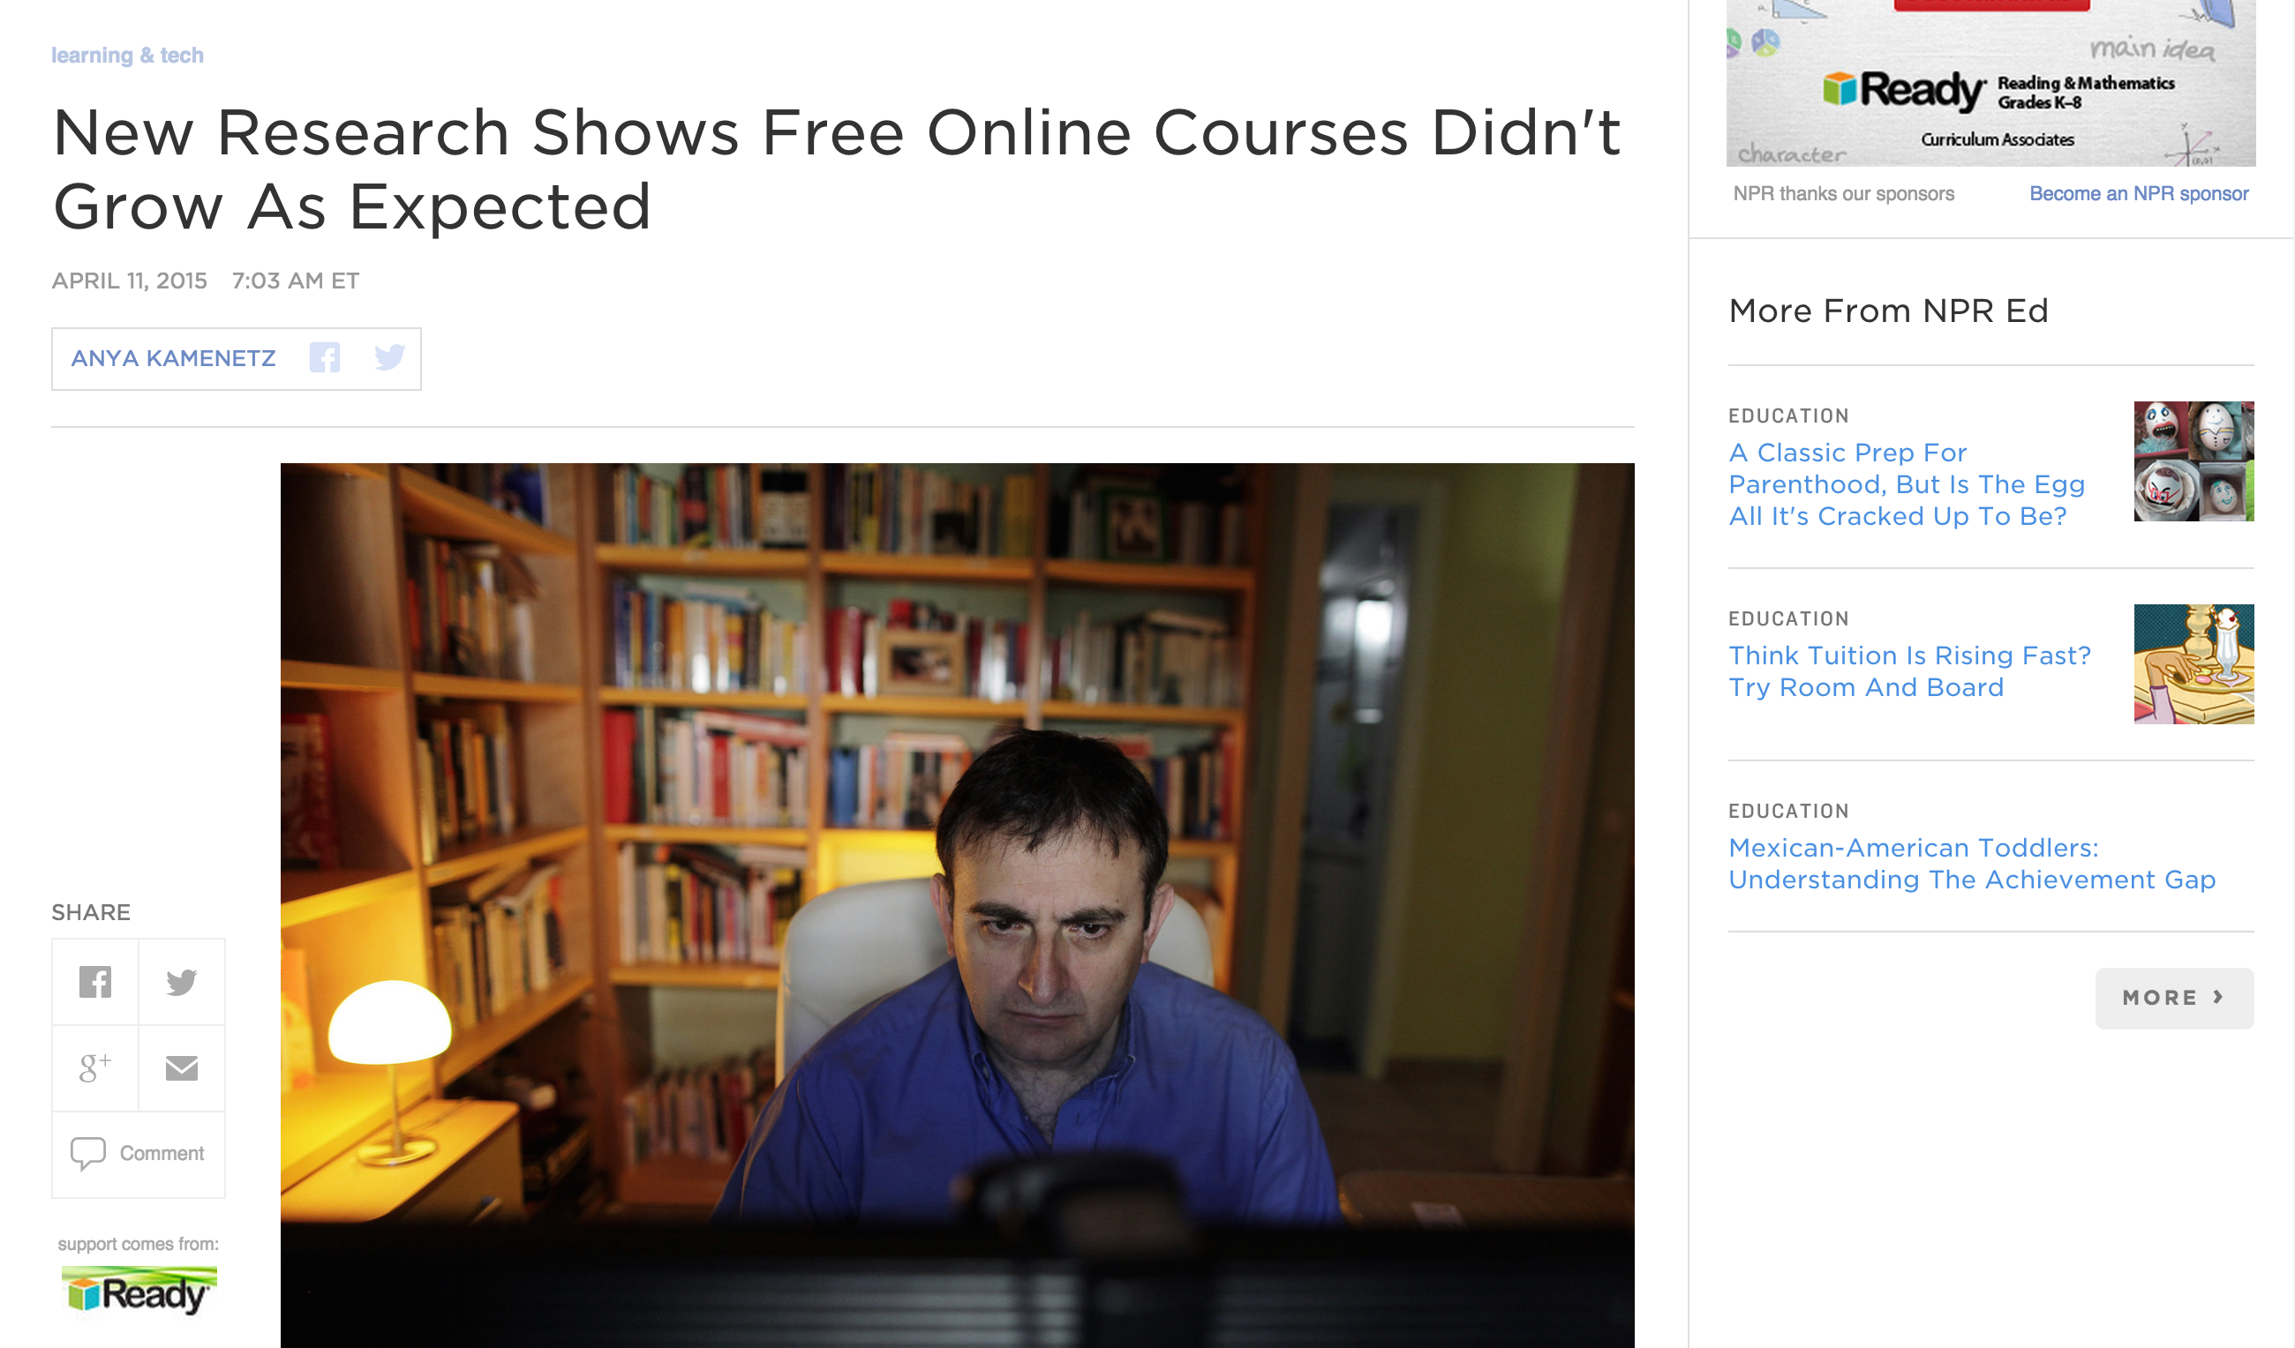
http://www.npr.org/blogs/ed/2015/04/11/397295495/the-future-of-free-online-courses-new-research-from-mit-and-harvard
Notes:
People who are not really involved have a lot of time on their hands. Those of us doing this work are super busy and having lots of fun.

Slide 4
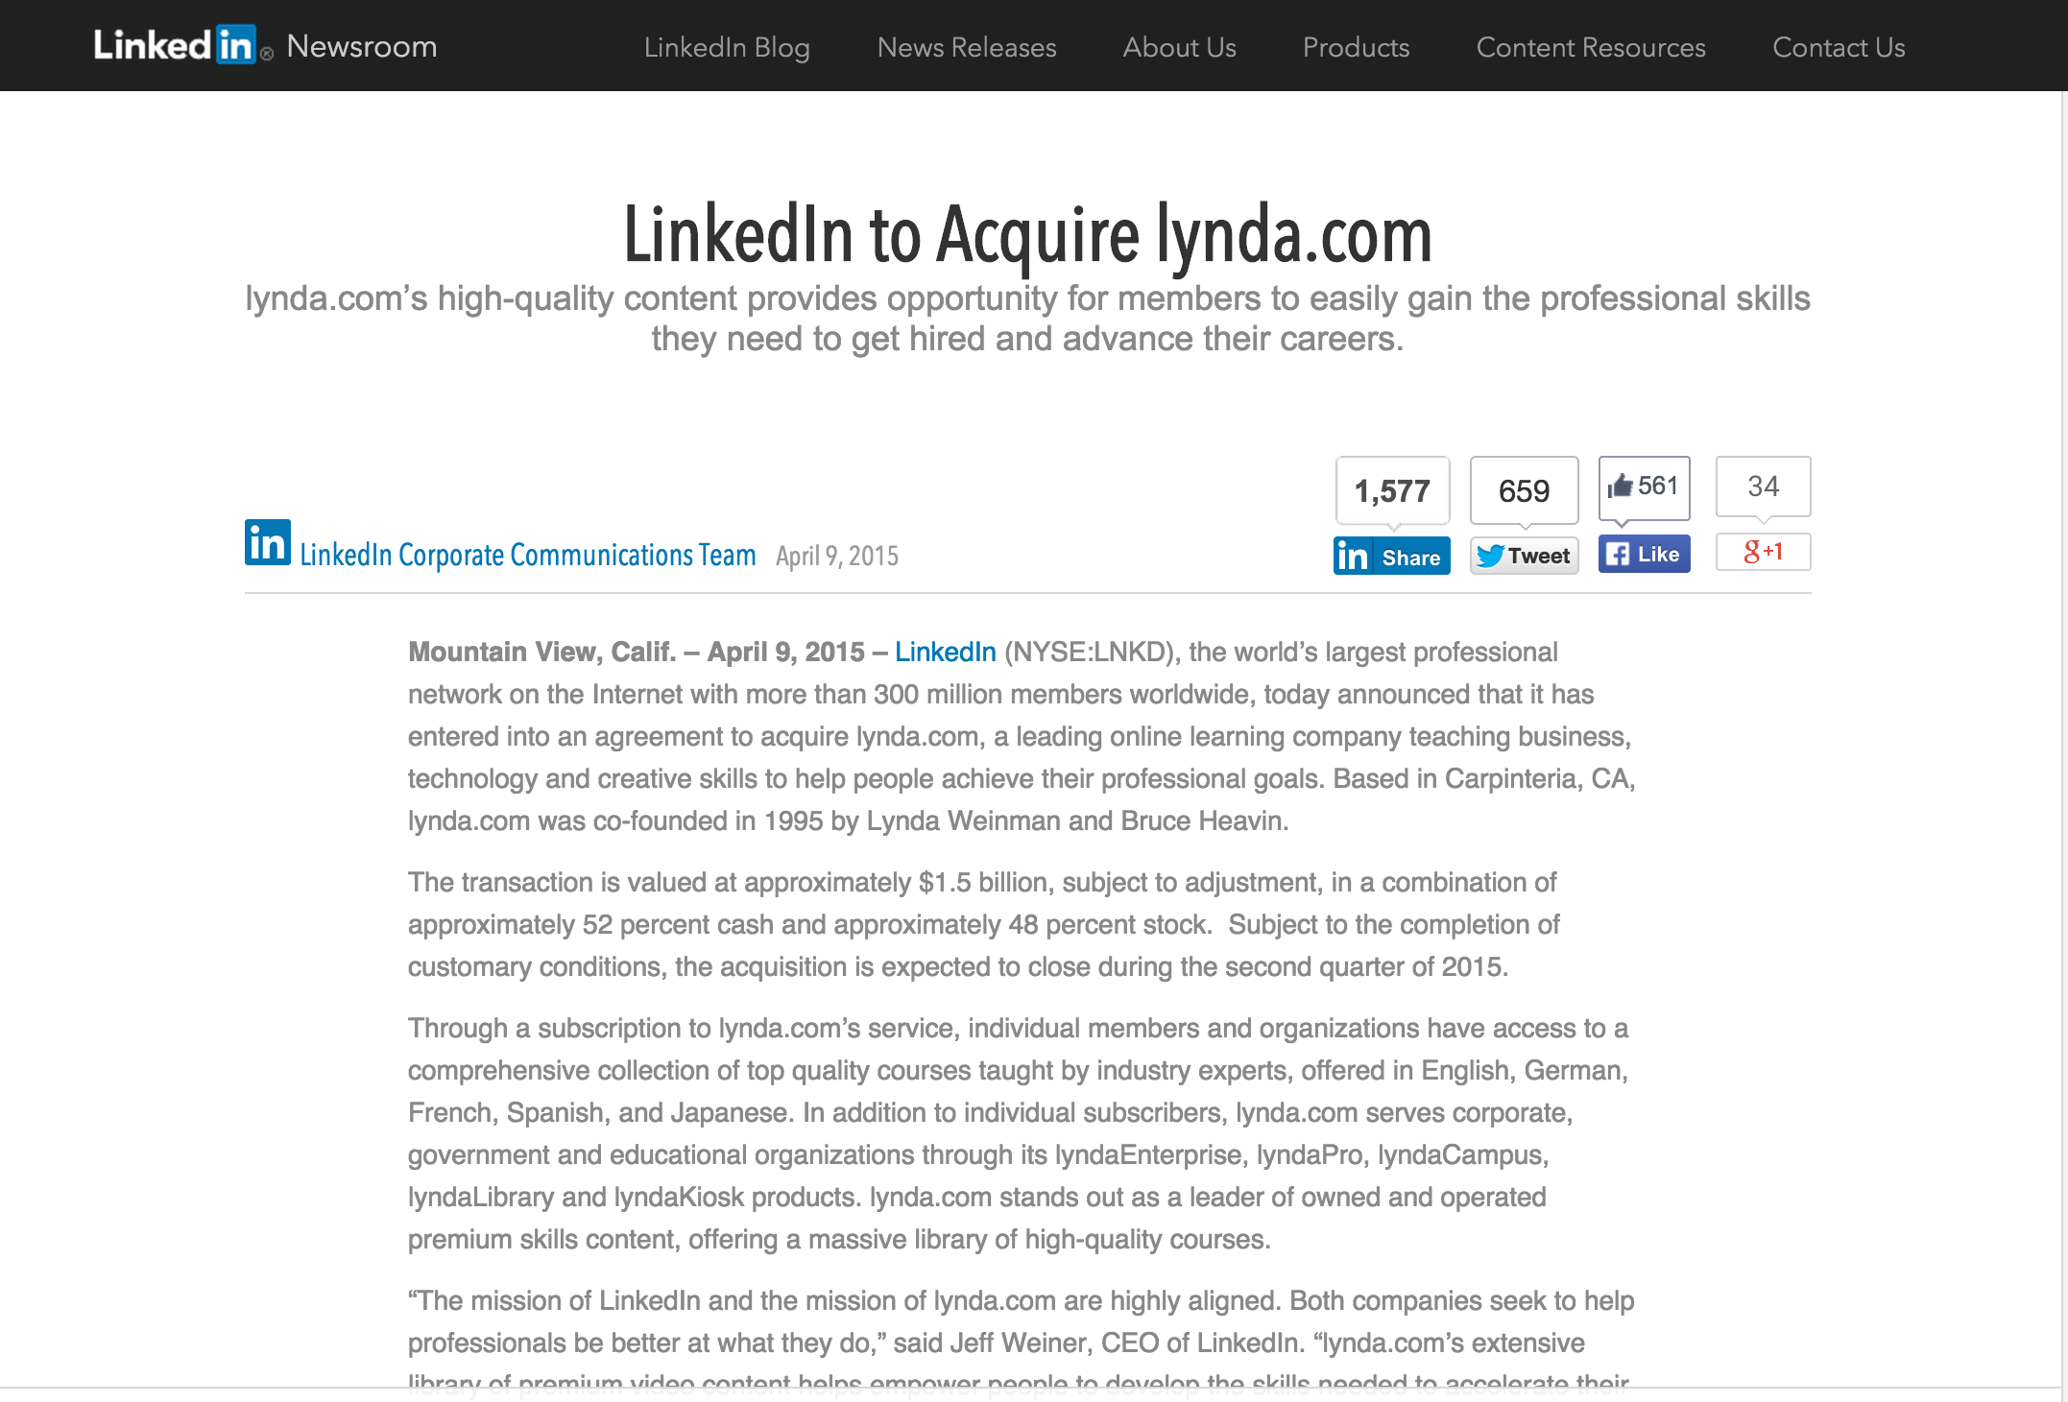
https://press.linkedin.com/site-resources/news-releases/2015/linkedin-to-acquire-lyndacom

Slide 5
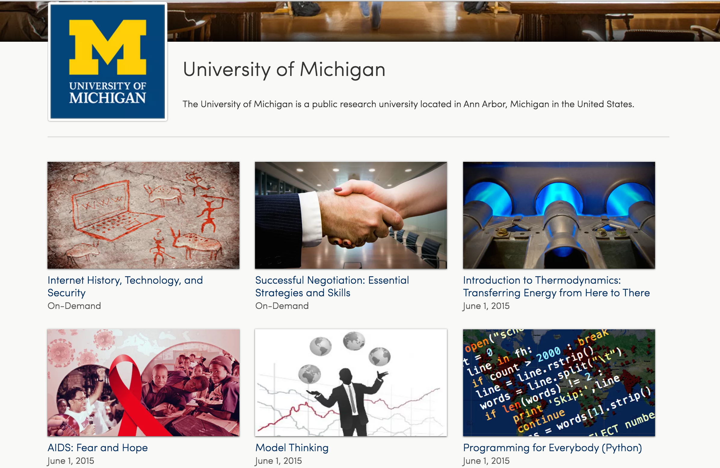
Notes:
It is a responsibility of a public university to lead and define this new space MOOC "Semesters" First week of February, June, and October 30+ courses per year 15 Support Staff Galvanizing education research on campus Learning Analytics Pedagogy

Slide 6
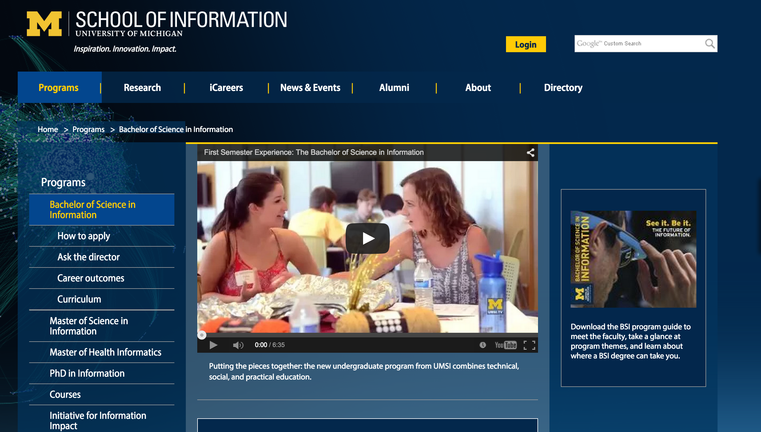
Python, R, JavaScript, Java, PHP, SQL, Swift, Statistics, Visualization, Economics, Game Theory, Motivation, Network Analysis, Interaction Design, Data Mining...
Notes:
Evaluation, Design and Implementing Technology systems BSI, Python, R, JavaScript, Java, PHP, SQL, Swift, ObjectiveC. Statistics, Visualization, Economics, Game Theory, Motivation, Network Analysis.

Slide 7
Python, R, JavaScript, Java, PHP, SQL, Swift, Statistics, Visualization, Economics, Game Theory, Motivation, Network Analysis, Interaction Design, Data Mining...
Notes:
Evaluation, Design and Implementing Technology systems BSI, Python, R, JavaScript, Java, PHP, SQL, Swift, ObjectiveC. Statistics, Visualization, Economics, Game Theory, Motivation, Network Analysis.

Slide 8
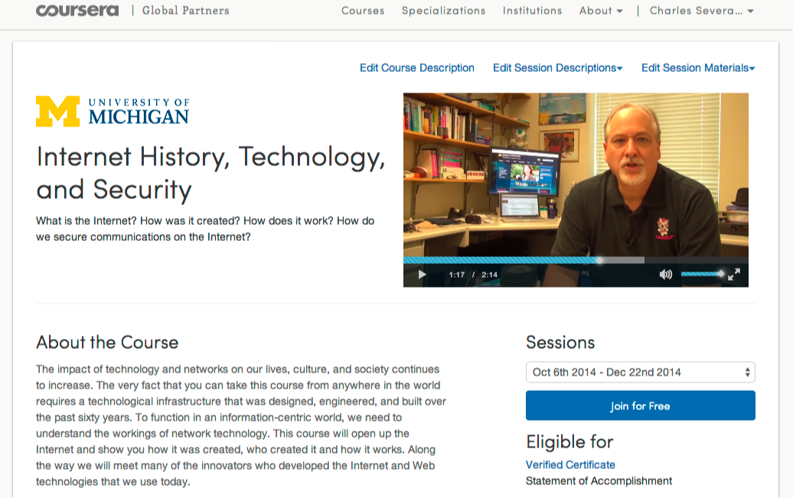

Slide 9
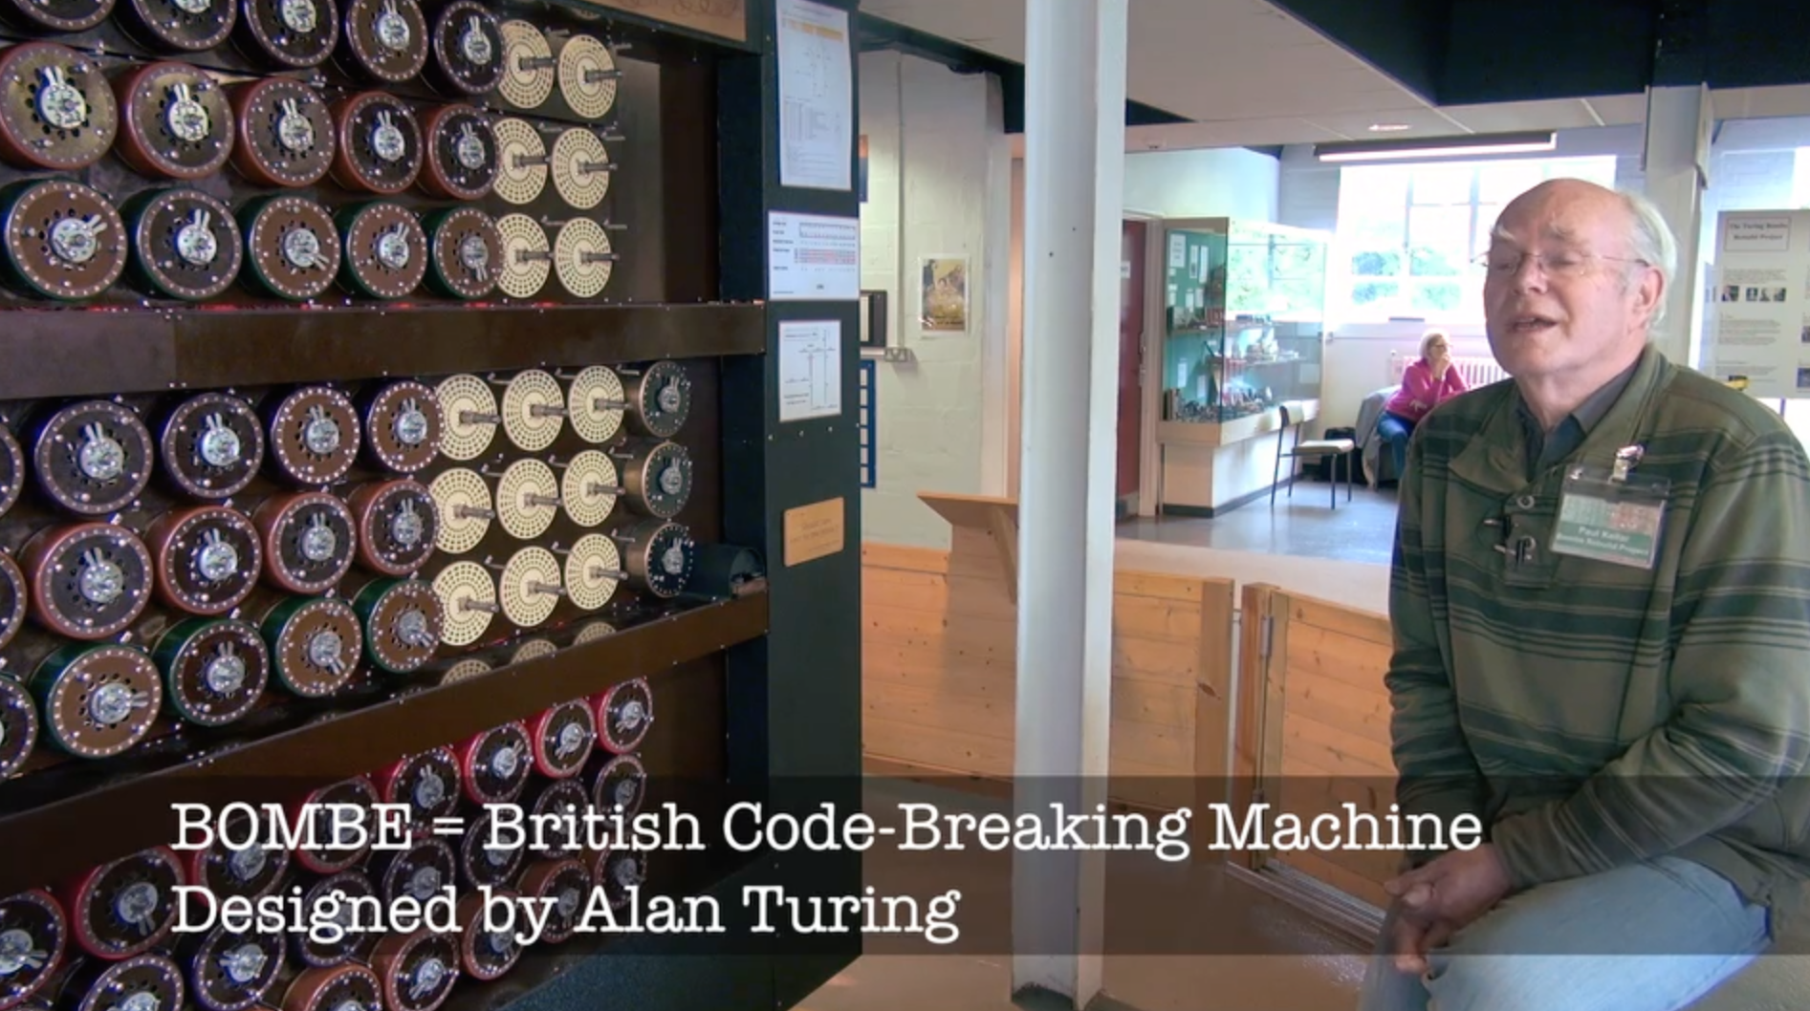
https://youtu.be/5nK_ft0Lf1s

Slide 10
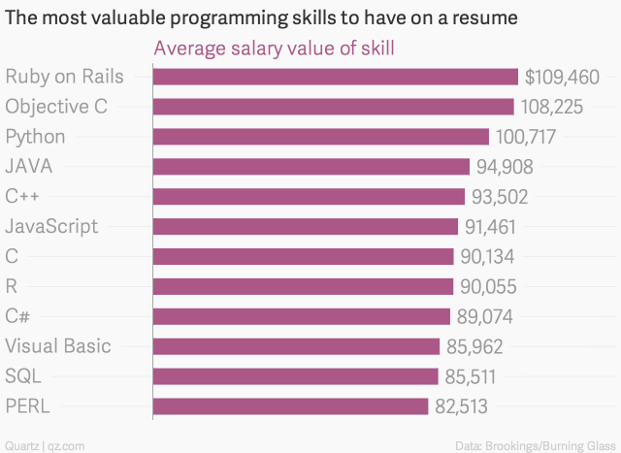
http://qz.com/298635/these-programming-languages-will-earn-you-the-most-money/

Slide 11
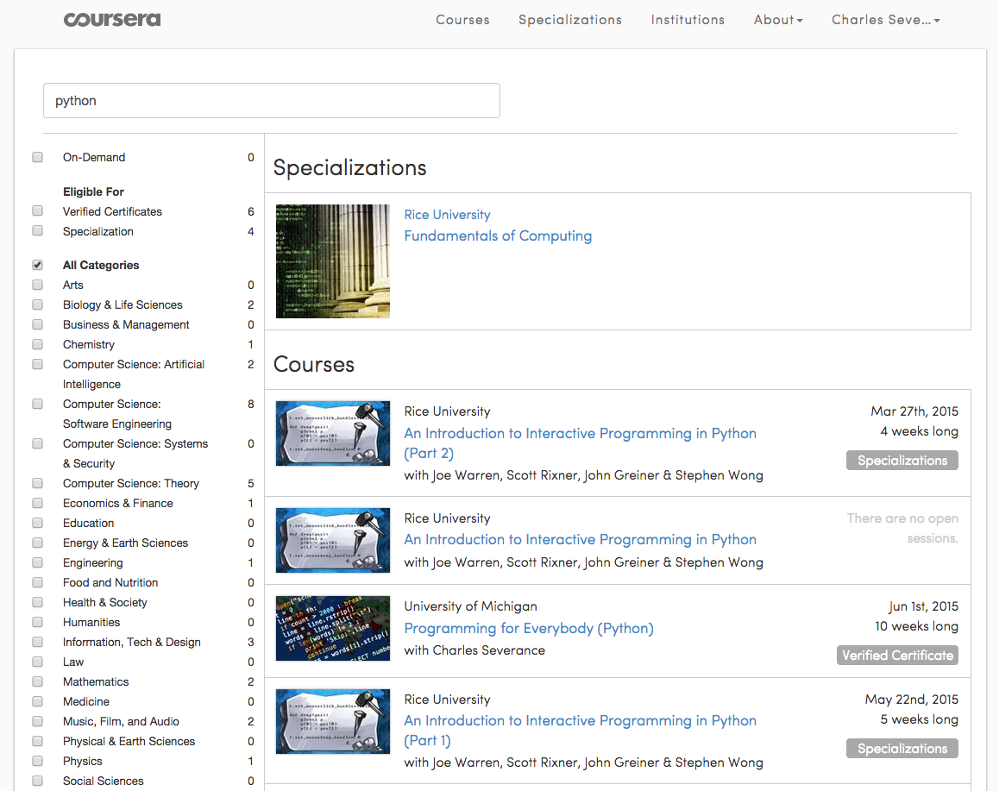
>12 Million Students

Slide 12
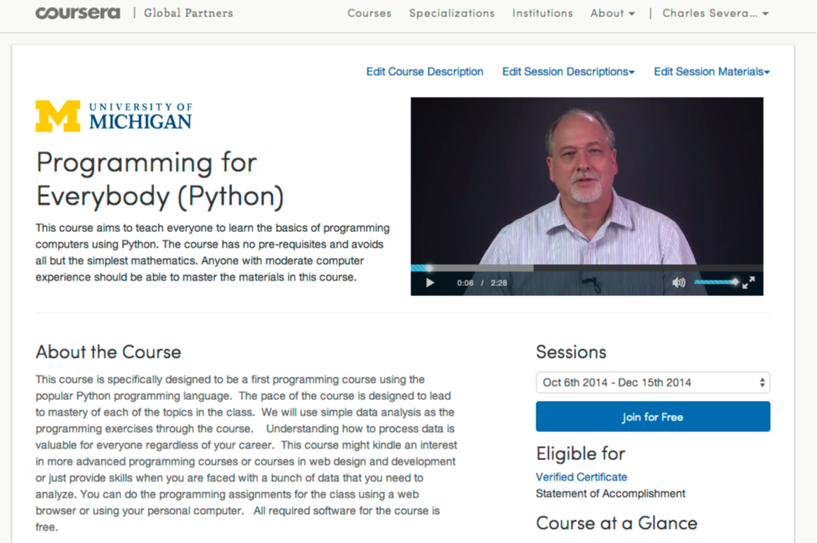

Slide 13
562,767 Total Enrollment
> 350K Revenue
27K Certs in 2014

Slide 14


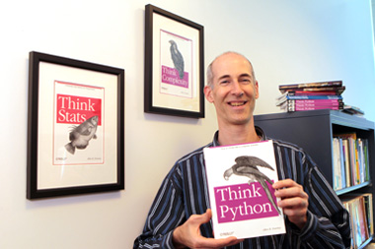
A Free Book
www.pythonlearn.com

Slide 15
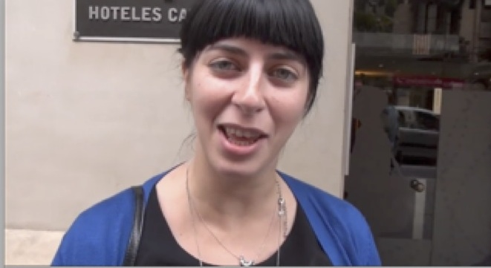
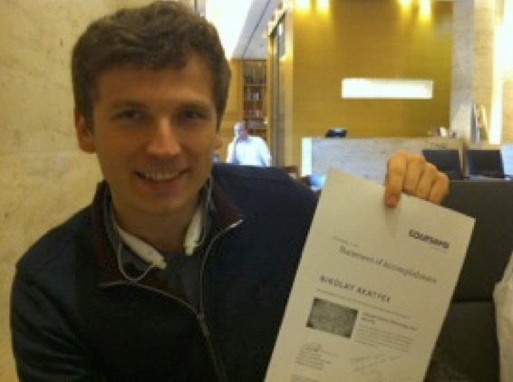
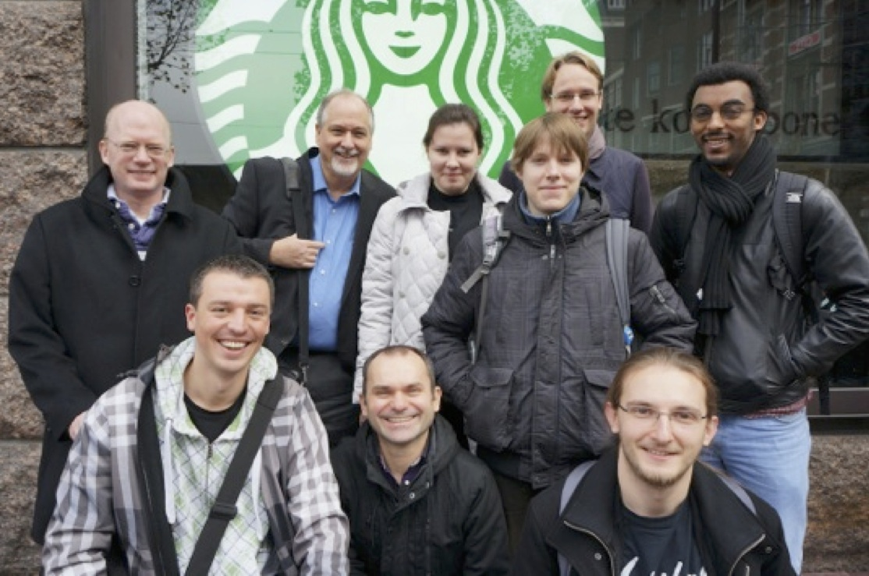
New York, Los Angeles, Ann Arbor, Chicago, Washington DC, Memphis, Seattle, Seoul, Barcelona, London, Mexico City, Amsterdam, Manila Melbourne, Perth...
office-hours.dr-chuck.com
Notes:
Since I have a very active travel schedule, I decided to hold office hours in the major cities I have visited in the past 18 months. I have held office hours in over 15 cities and in each location somewhere between two and 15 students show up.

Slide 17
Advancing FREE / Open
Notes:
What is wrong with this picture??

Slide 18
One of these things is not like the others:
www.masteringphysics.com
www.masteringastronomy.com
www.masteringpython.com

Slide 19


Slide 20
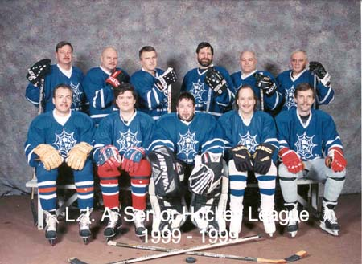
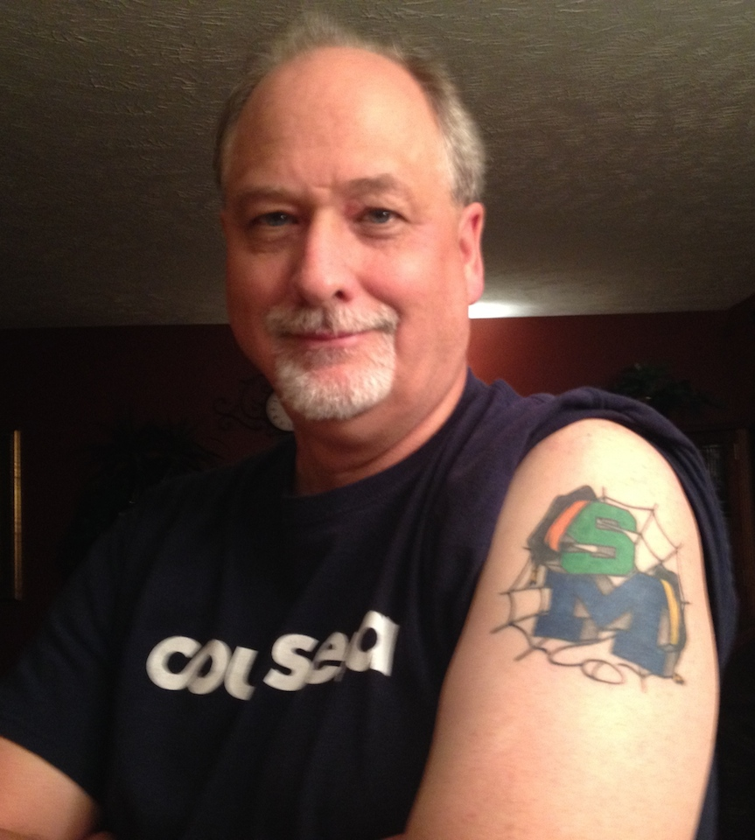

Slide 21
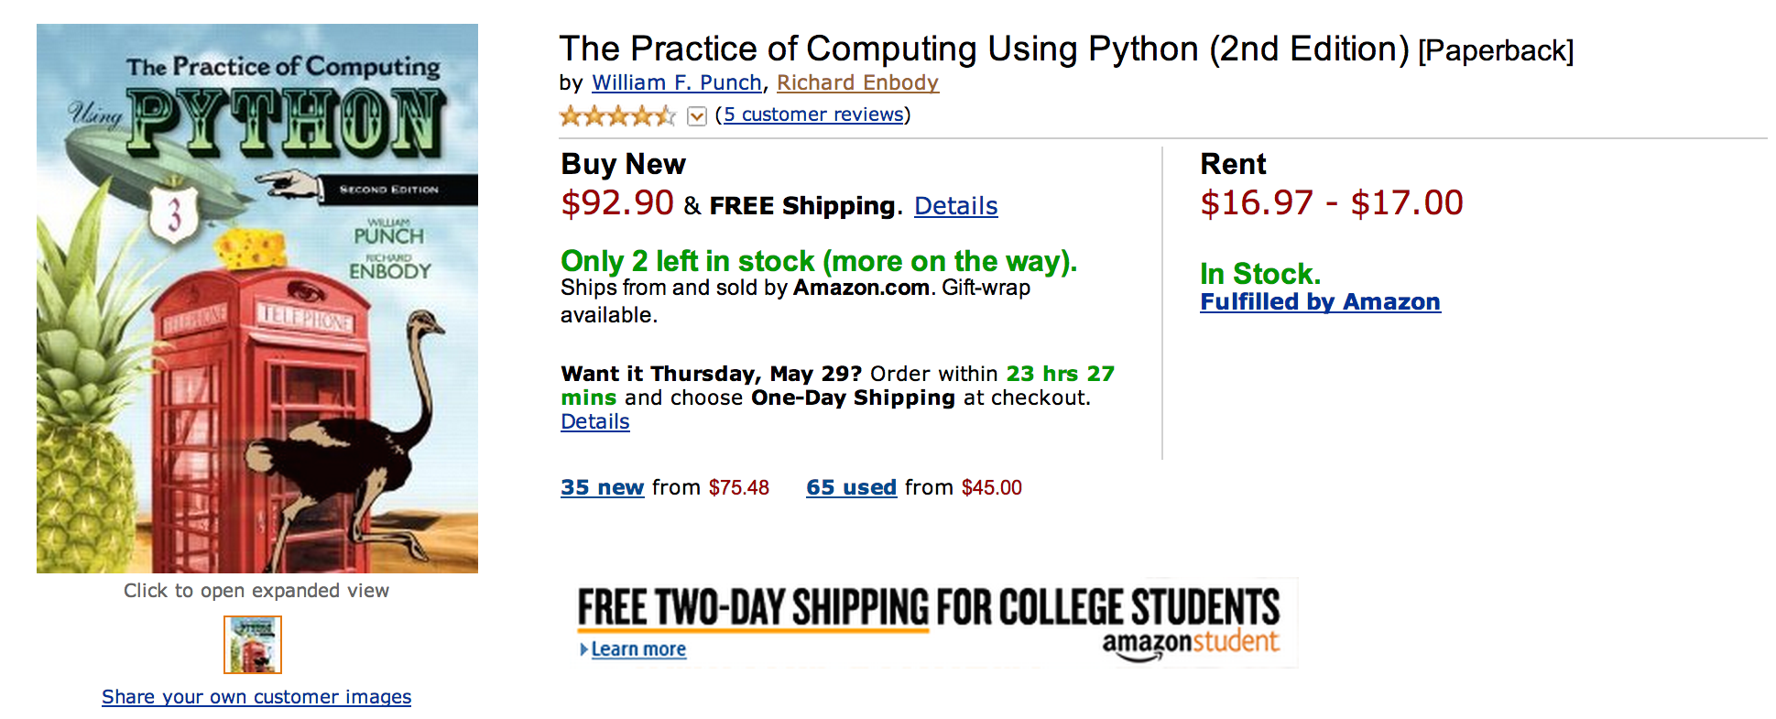
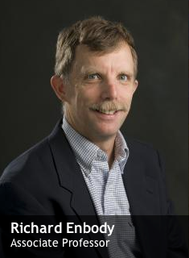
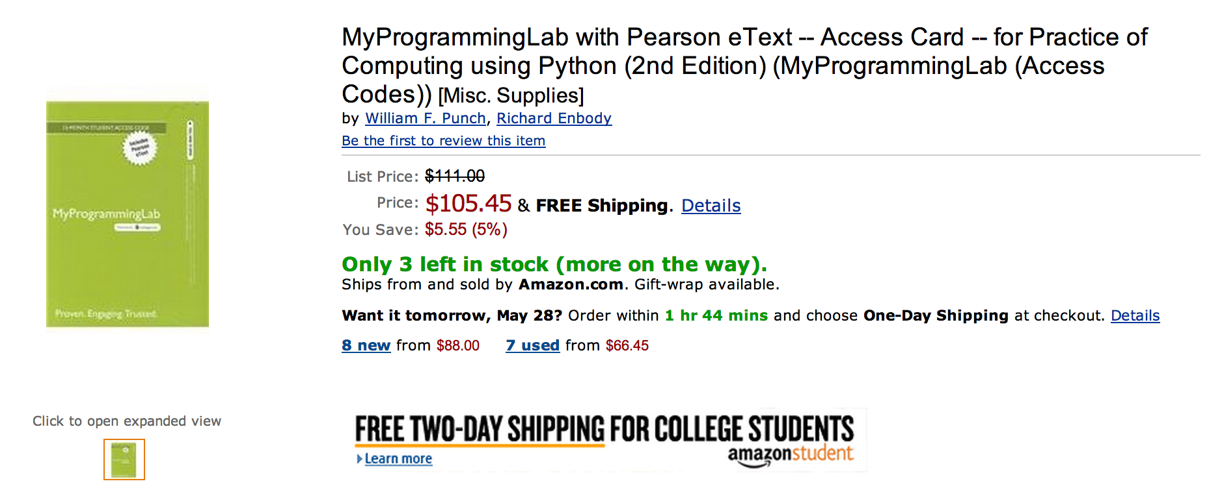

Slide 22
What does $198.35 get you?
Book
Automatic Homework Grading Software
Learning Management System Integration
Instructor Materials
Slides / Solutions Manual / Exams / Course Copy
Instructor Training
3-5 days from notification to full course
Notes:
$65 from Pearson $130 Form bookstore

Slide 23

Teacher Prep
Book
Pearson Value
Proposition
$200
Marketing
Software

Slide 24
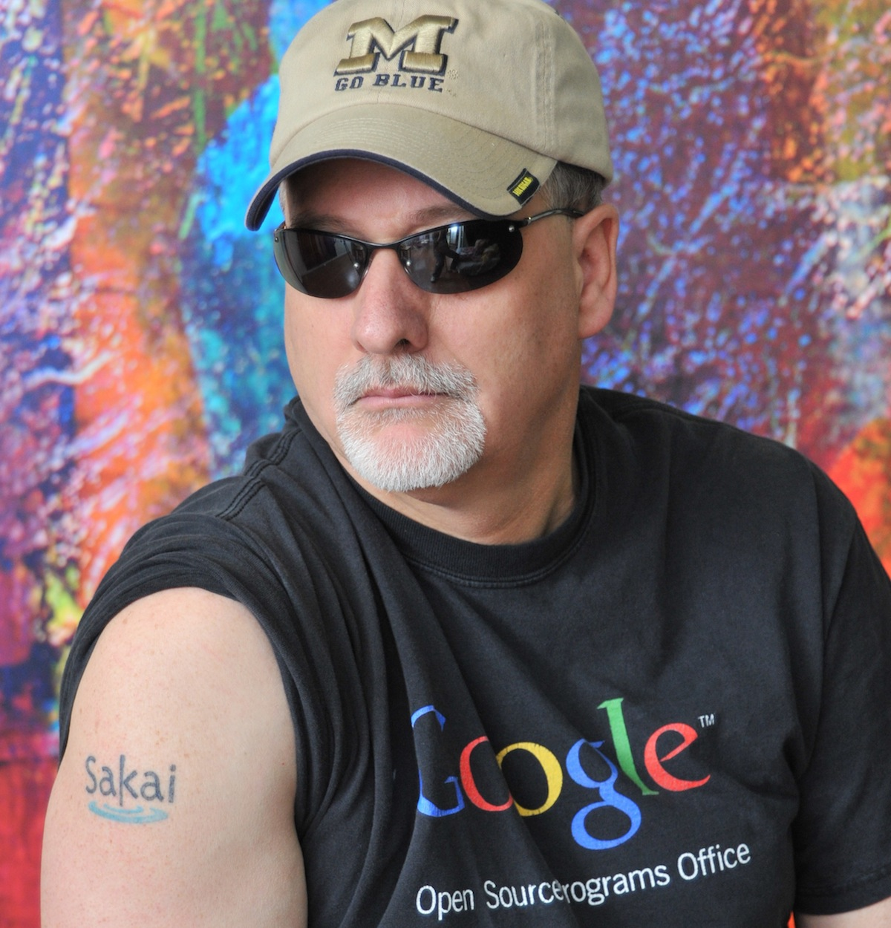
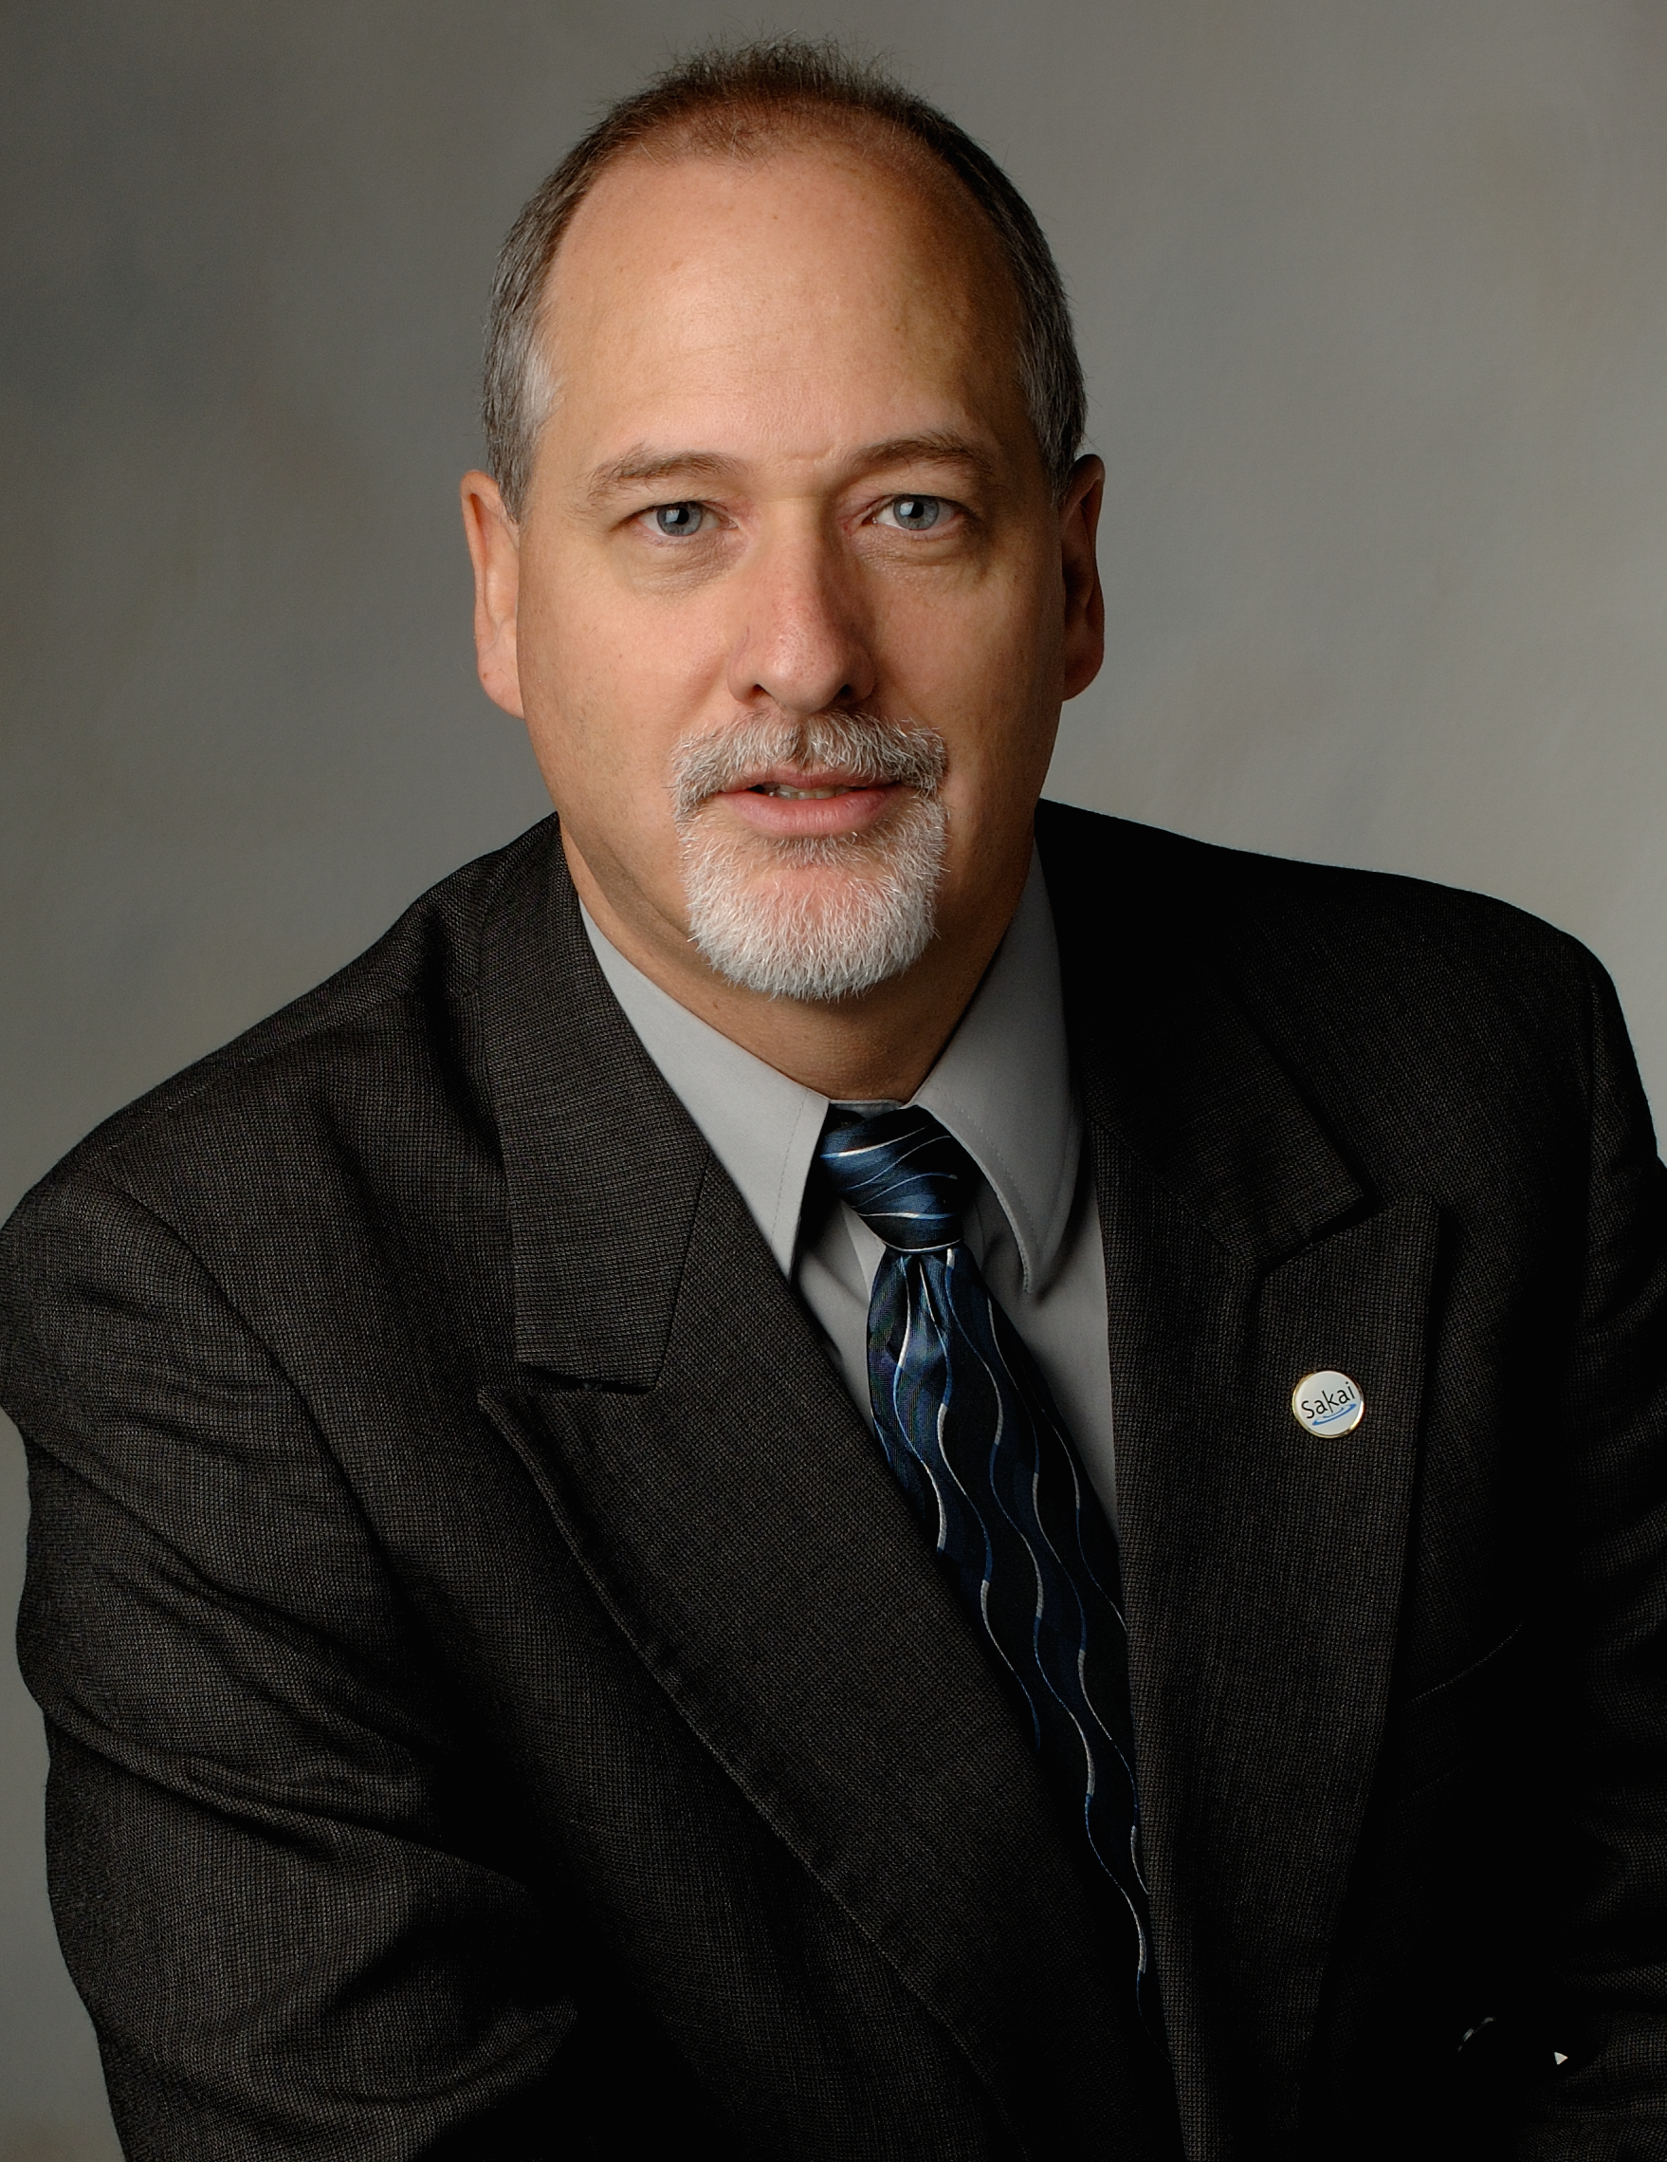



Slide 25
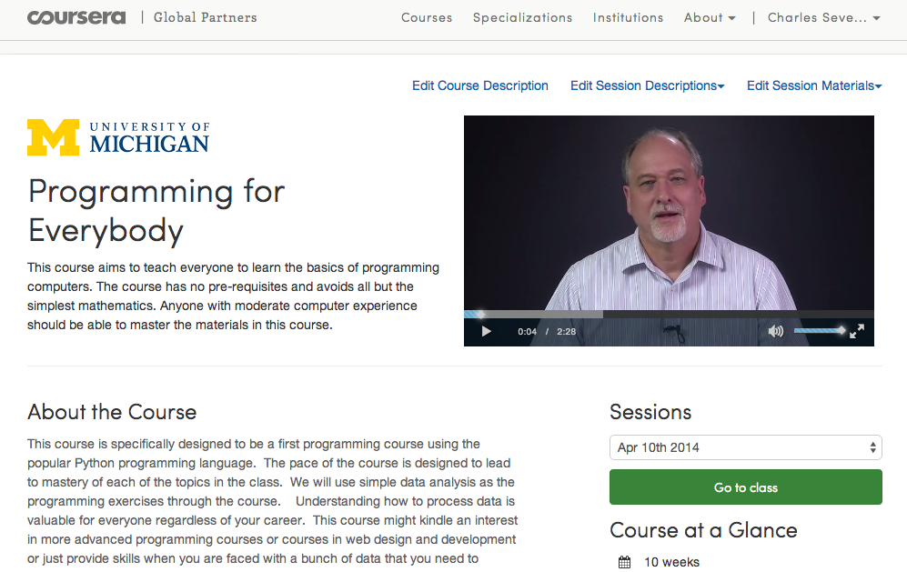

Slide 26
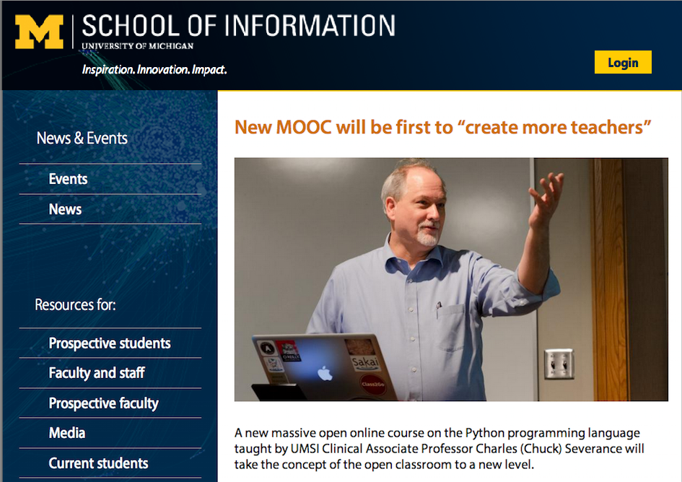

Slide 27
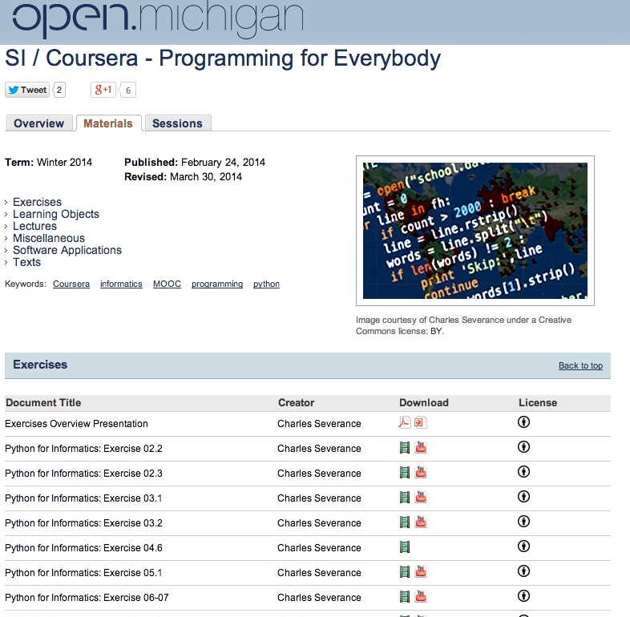

Slide 28
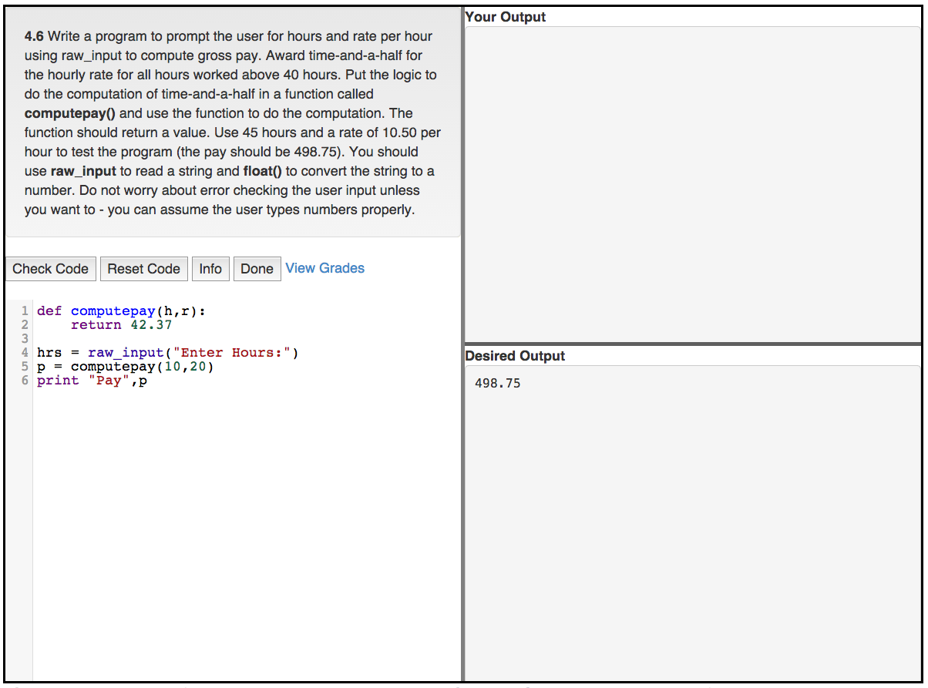


Slide 29
Teacher Prep
Book
Value
Proposition
Software
Free (or $9)
Marketing
Community
Notes:
Will I get

Slide 30
FREE IS DIFFERENT...

Slide 31

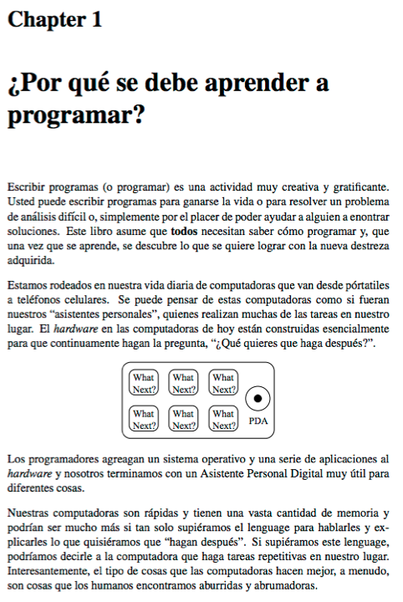
Free Translations
slides.pr4e.org
translate.pr4e.org

Slide 32
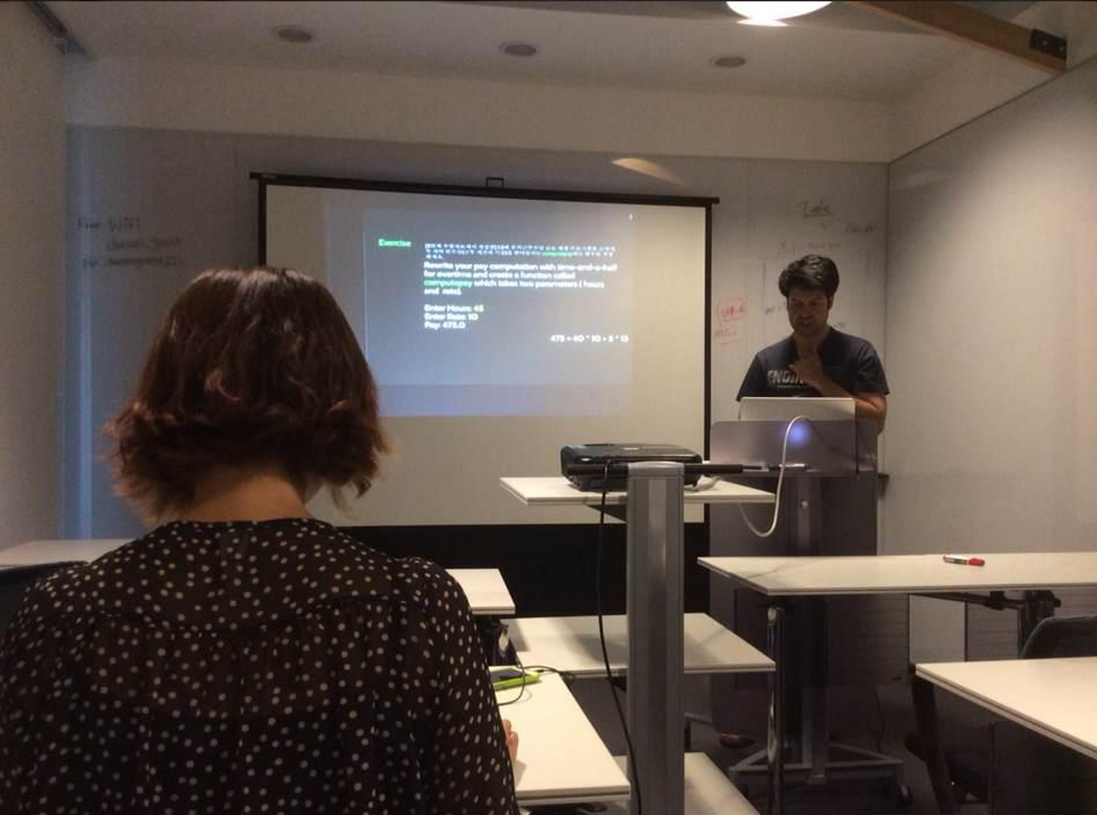
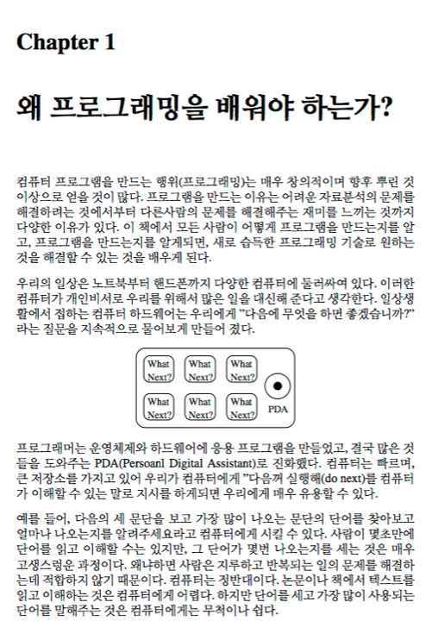
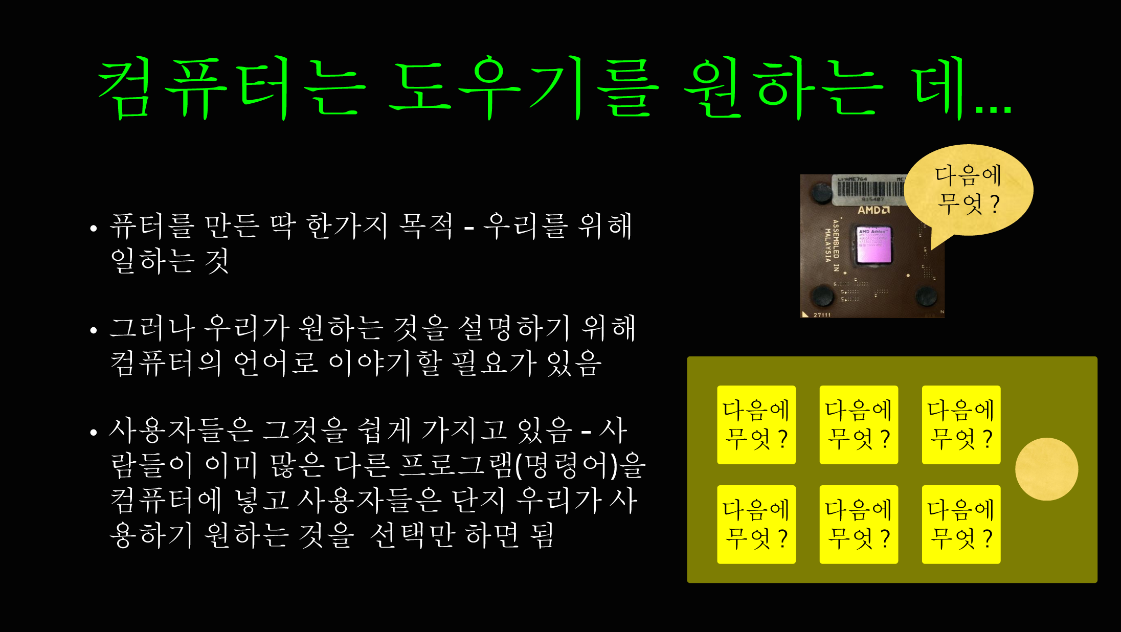


Slide 33
That was one course

Slide 34
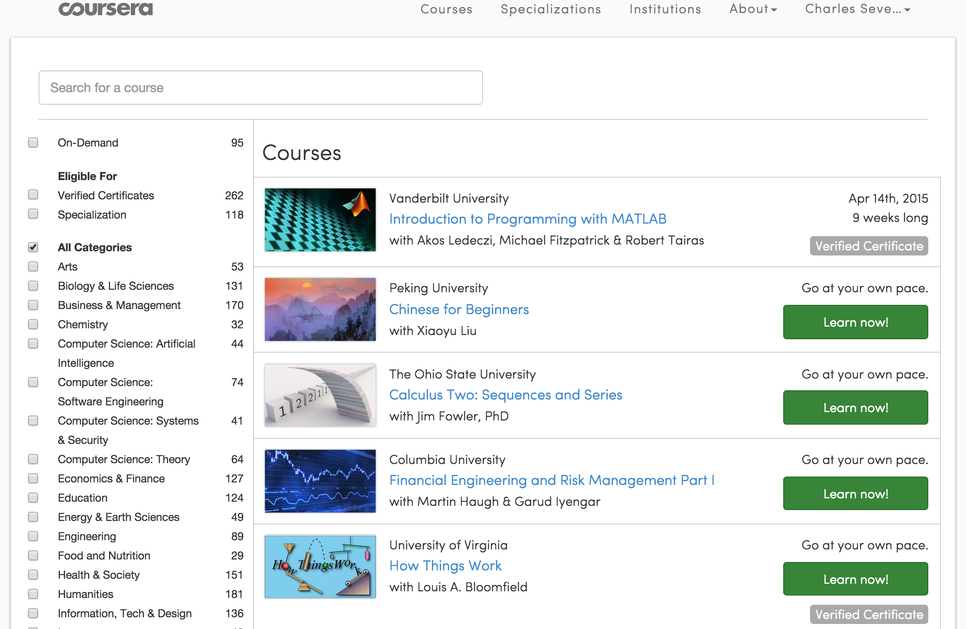
>1000 Courses
>115 Institutions
>12M Students

Slide 35
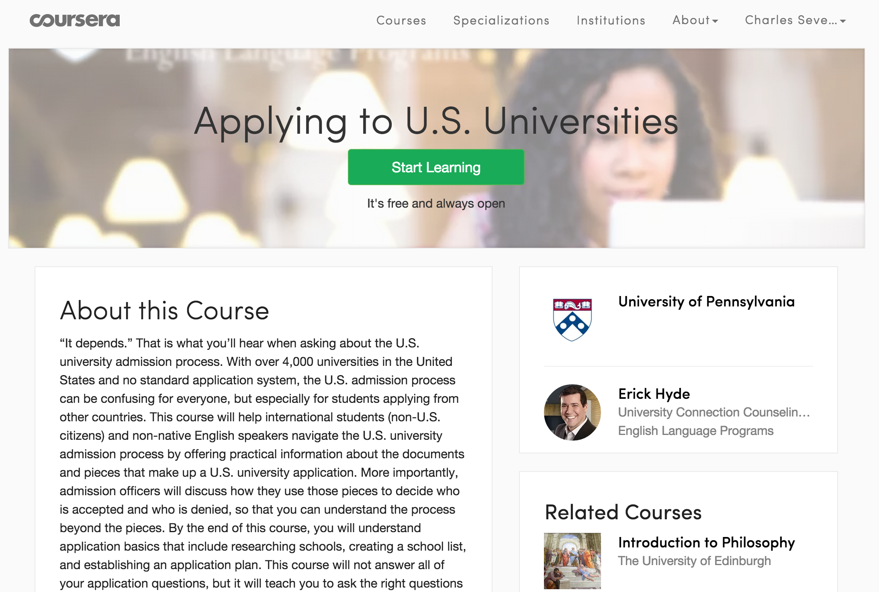

Slide 36
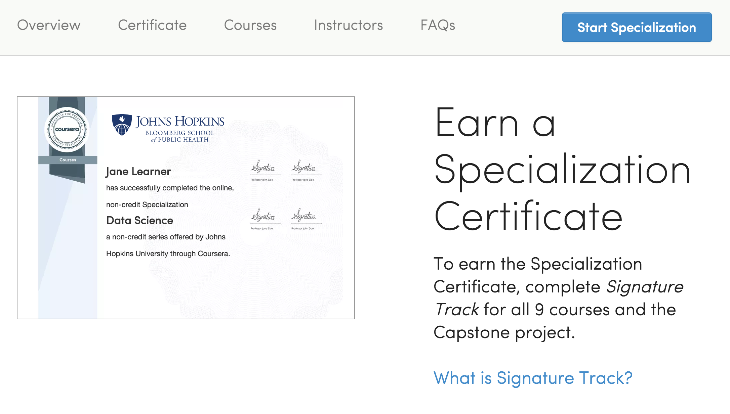

Slide 37
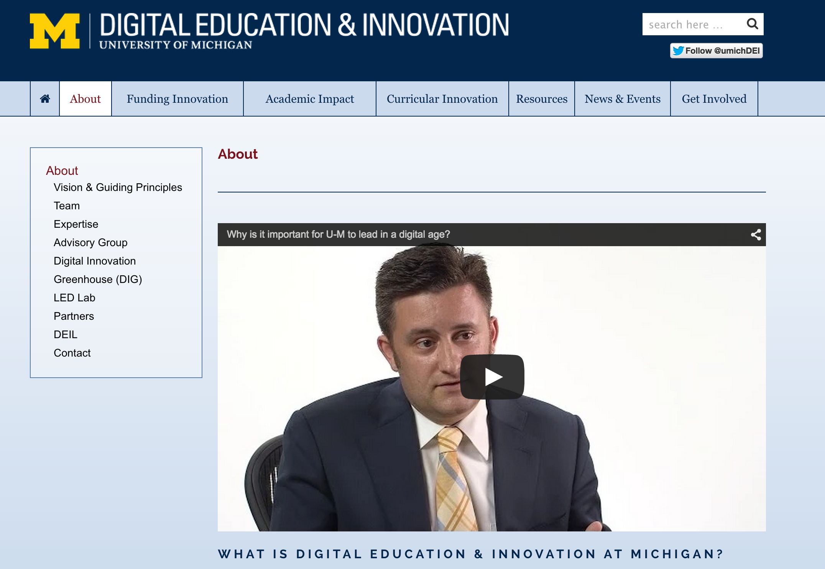
Notes:
It is a responsibility of a public university to lead and define this new space MOOC "Semesters" First week of February, June, and October 30+ courses per year 15 Support Staff Galvanizing education research on campus Learning Analytics Pedagogy

Slide 38
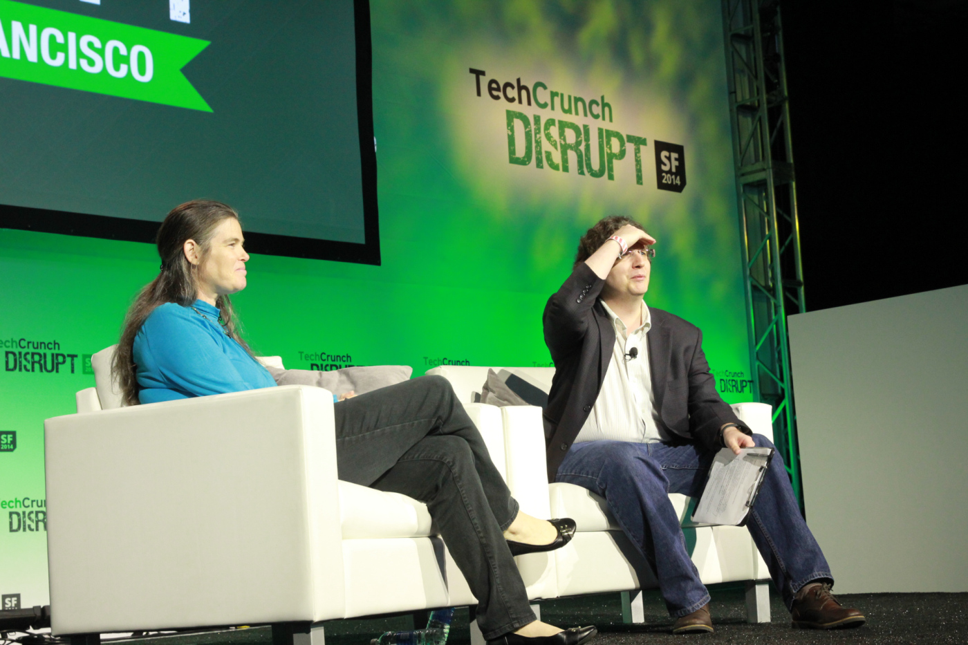


Coursera’s president Daphne Koller pushed back against the notion that her company is a for-profit education company: In her view, Coursera is instead a for-profit technology company.
http://techcrunch.com/2014/09/10/coursera-president-daphne-koller-2014-is-the-year-moocs-will-come-of-age/
Notes:
Market... Like the 1.5 Bn – Lynda you will be surprised – and the mainstram media will give no insight.

